Slide 1


DevOps and Internal Audit:
A Great Partnership
DevOps Enterprise Summit 2020

Slide 2
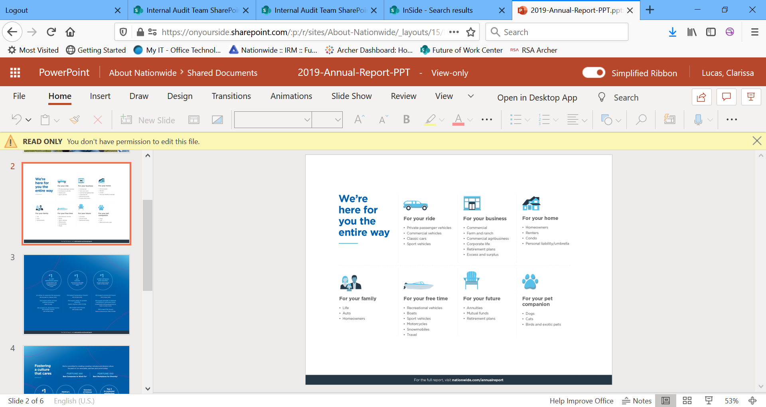
About Nationwide

Slide 3
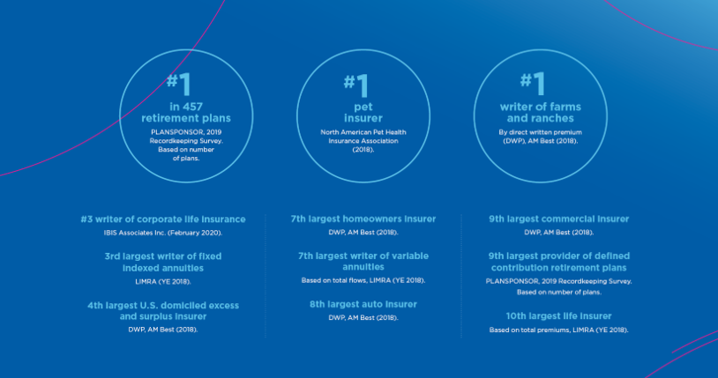
About Nationwide

Slide 4
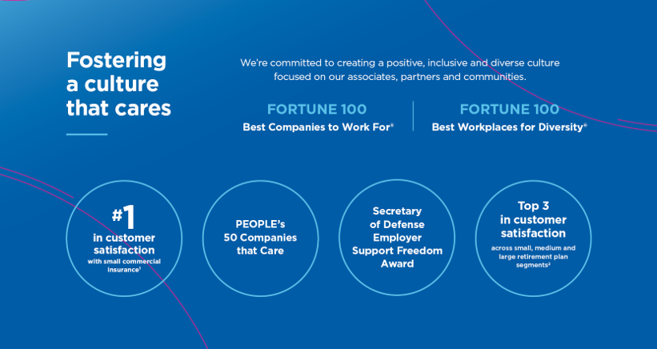
About Nationwide

Slide 5

Learning Objectives
By attending this session, attendees will learn:
To change the way they think about risks and controls, including how they’re performed and assessed.
How DevOps can positively impact their experience during an internal audit (enabling greater self-service, increased use of analytics, reduced manual activity, etc.).
This Photo by Unknown Author is licensed under CC BY-SA-NC

Slide 6
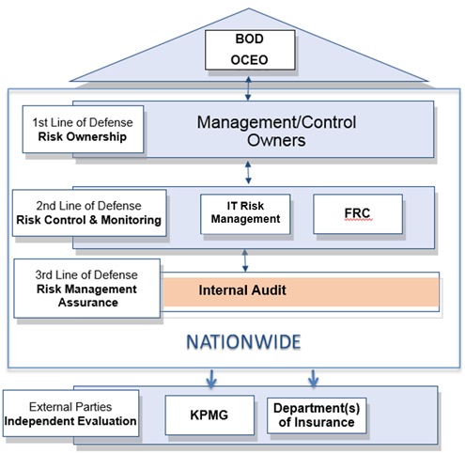
The Three Lines of Defense
Introduction – Internal Audit
Our Purpose:
Provide independent assurance to the Audit Committee of the Board
Add value and improve operations
Evaluate and improve the effectiveness and efficiency of risk management, governance and control processes
Independently assess the adequacy and effectiveness of risk management and control activities
Link to DevOps through integrated audits
Test applications supporting key business processes
Primary controls:
Change management
User access
Interface integrity

Slide 7

DevOps – Driving Value or Exposing Risk?
DevOps impacts Security and Audit practitioners:
Continuous delivery and balancing control execution with speed
Maximizing automation:
Changes how traditional controls are designed and performed
Leads to modified methods of assessing controls
Segregation of duties may require less human involvement
Need for defined DevSecOps principles
Security of CI/CD pipeline
Secure application development

Slide 8
Key Change Management Risks
Lack of proper mitigation controls may lead to decreased or compromised system/data availability, integrity, or confidentiality, resulting in adverse impact on business operations.
A strong control environment helps manage this risk by preventing:
Unauthorized changes introduced into production
Code that does not perform in alignment with expectations
Unidentified dependency issues
Changes resulting in unintended consequences
Introduction of security vulnerabilities

Slide 9
Traditional Change Management Controls
Approvals
Changes should be tested and approved before moving into production by a person other than the developer
Supporting documentation for changes should be maintained
Segregation of Duties
Migration of changes into production should be done by a person who is independent from the development team
Metrics Monitoring
Monitoring and reporting should be in place to determine effect of changes on business operations

Slide 10

SOD – Why?
Why do we separate certain duties?
To prevent…

Slide 11
SOD – Why?
Why do we separate certain duties?
To prevent…
Improper modification of data
Misappropriation of assets
Erroneous changes to programs
Errors
Malicious acts
Fraudulent acts

Slide 12

SOD – What if?

Slide 13
SOD – What if?
Review of transaction logs
Exception reporting
Automated enforcement of signed artifacts
Automated reviews/tests
Review of audit trail
Reconciliations

Slide 14
Traditional Change Management Controls
Approvals
Changes should be tested and approved before moving into production by a person other than the developer
Supporting documentation for changes should be maintained
Segregation of Duties
Migration of changes into production should be done by a person who is independent from the development team
Metrics Monitoring
Monitoring and reporting should be in place to determine effect of changes on business operations

Slide 15

DevOps-Centric Approach to Change Management
Determine which changes require separate approvals
Determine which changes can be pre-approved (e.g., low risk, “routine” changes)
Monitor logs to ensure:
Only routine changes are made without a separate approval, and
Non-routine changes have a corresponding review/approval.

Slide 16
DevOps Risk and Internal Control Considerations
Category | Specific Risks | Controls
Governance | Developers may not be aware of secure coding techniques, security requirements and commonly occurring application vulnerabilities. | Developer application security training Documented policies and procedures
Secure Delivery Pipeline and Change Control | Poorly secured delivery pipeline may lead to production breaks and security vulnerabilities in applications. Implementing untested and/or unauthorized code may lead to increased operational failures, poor transaction processing, and unreliability of the system. Unauthorized changes may be deployed into production. | Protect source code Detect and address unencrypted sensitive data Automated application code vulnerability scanning Automated test execution Automated configuration vulnerability scanning Software dependency management Restricted access Automated production deployment process Access and activity logging Data protection Automated approvals and verifications
Operations | Without proper monitoring and metrics collection/review, technology performance may degrade over time. | Technology performance management Asset management and inventorying

Slide 17

The Audit Experience
What is the impact to your audit experience? Why are DevOps and Audit a great partnership?
Greater reliance on automated controls = smaller sample size = less time spent being audited
Fewer requests for evidence/documentation = decreased interruption to daily responsibilities
Ability to extract evidence directly from source systems = greater self-service by Internal Audit = fewer requests for evidence/documentation to fulfill
Greater reliance on automated controls with audit trails = greater assurance via full population coverage
This Photo by Unknown Author is licensed under CC BY-SA-NC

Slide 18

How to “Pass an Audit”
How can you “pass an audit” in a DevOps environment?
No magic formula
Understand risks to achieving objectives
Perform controls to mitigate those risks
Manage risk within defined tolerances
Maintain evidence of control performance
Collaborate with Internal Audit throughout the year (not just during an audit)
This Photo by Unknown Author is licensed under CC BY-ND

Slide 19


Contact Information
Clarissa Lucas, Audit Director
Nationwide Insurance
lucasc5@nationwide.com
https://www.linkedin.com/in/clarissa-lucas-cia-cida-38b96832
Rusty Lewis, Audit Specialist
Nationwide Insurance
lewir7@nationwide.com
https://www.linkedin.com/in/rusty-lewis-cpa-69a96347

